Slide 1
Working with jQuery Mobile

Slide 2
Objectives
In this session, you will learn to:
  Create a basic jQuery Mobile Web application with navigation

Slide 3
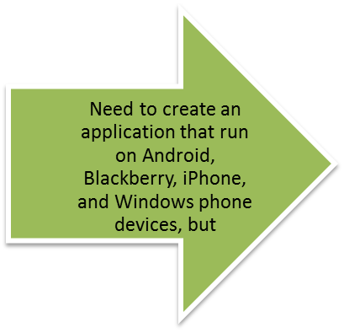

Creating a jQuery Mobile Application
Scenario:
Android and Blackberry applications are written in Java
iPhone applications are written in Objective C
Windows phone applications are written in .NET languages
To create
cross-platform Web applications, use
Creating multiple applications using different programming languages is tedious and time consuming
jQuery Mobile
Use the animation, RWD_09_jQuery_Mobile, to
understand the concept of jQuery Mobile.

Slide 4
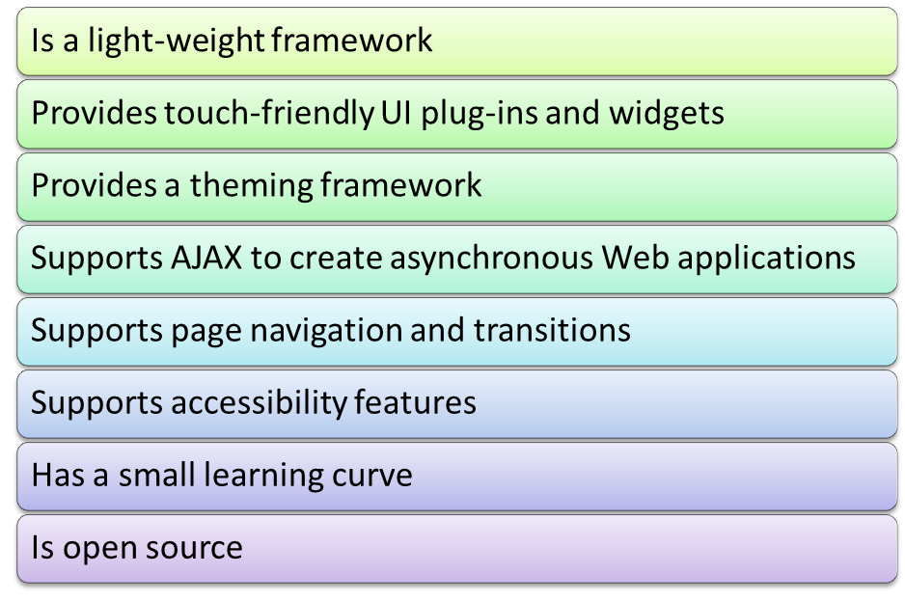
Identifying Features of jQuery Mobile
jQuery Mobile is a UI framework that you can use to create cross-platform Web applications for a wide range of mobile devices.
It uses HTML5, CSS3, and jQuery JavaScript library, which are supported by all mobile Web browsers.
Some of the common features of jQuery Mobile are.

Slide 5
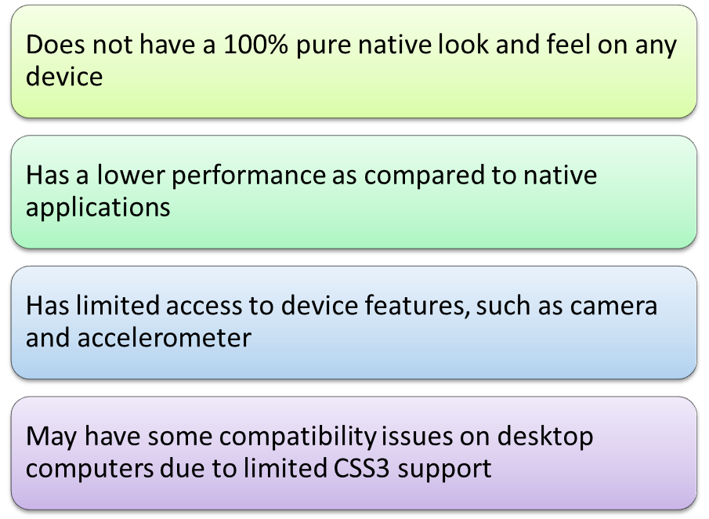
Identifying Features of jQuery Mobile (Contd.)
jQuery Mobile has some limitation over native applications.

Slide 6
Getting Started with jQuery Mobile
To start using jQuery Mobile in your Web page, you need to refer to the jQuery Mobile library. For this:
  Download the latest stable version of jQuery Mobile from the http://jquerymobile.com/download/ url.
  Extract the downloaded compressed file.
  Create a Scripts folder in your website in WebMatrix.
  Copy the jQuery Mobile library files in the Scripts folder.
  Include the jQuery and jQuery Mobile library files in the <head> </head>
  section of your Web page, as shown in the following code snippet:
<head>
<link rel='stylesheet' href='Scripts/
jquery.mobile-1.4.5.css'/>
<script src='http://code.jquery.com/
jquery-1.11.1.min.js'></script>
<script src='Scripts/
jquery.mobile-1.4.5.min.js'></script>
</head>

Slide 7
Creating a Basic jQuery Mobile Application
The basic blocks of a jQuery Mobile application are HTML5 pages that get displayed on device screens.
To create a jQuery Mobile page, include the data-role="page" attribute in an HTML5 container element, such as the <div> or <section> element, as shown in the following code snippet:
A jQuery Mobile page typically contains a header, the page content, and footer.
While rendering the page on a device, jQuery Mobile will automatically enhance the controls by making them touch-friendly.
<body>
<div id="page1" data-role="page">
<h1>Welcome<br>To jQuery Mobile</h1>
</div> </body>

Slide 8
Creating a Basic jQuery Mobile Application (Contd.)
jQuery Mobile provides two types of page templates to create mobile
Web pages.
Single-page template
  Enables you to create a standard HTML5 document that acts as an independent Web page.
Multi-page template
  Enables you to add multiple pages within a single HTML document.

Slide 9
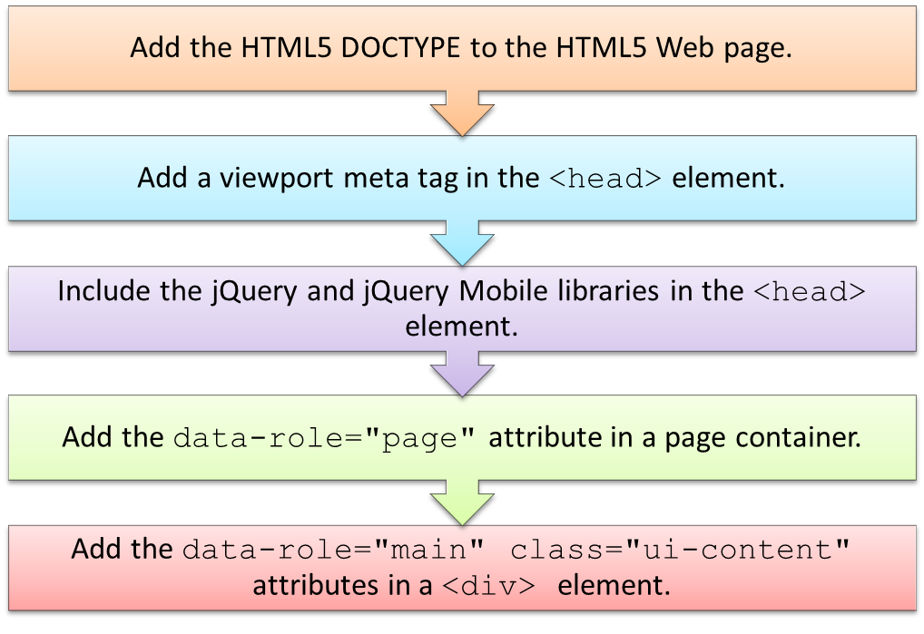
Creating a Basic jQuery Mobile Application (Contd.)
To create a basic jQuery Mobile page using the single-page template, you need
to perform the following steps:

Slide 10
Creating a Basic jQuery Mobile Application (Contd.)
The following code snippet shows how to create a basic jQuery Mobile page
using the single-page template:
<body> <div id="myPage" data-role="page">
<div id="content" data-role="main" class="ui-content">
<p>Welcome to JQuery Mobile</p>
</div> </div> </body>

Slide 11
Creating a Basic jQuery Mobile Application (Contd.)
A multi-page template contains multiple page containers each represented by
the data-role="page" attribute.
In this template, a unique page ID is used to identify each page and to navigate between the pages.
The following code snippet shows how to use the multi-page template in an HTML document:
<body>
<div id="page1" data-role="page">
<div id="content" data-role="main" class="ui-content">
<a href="#page2">Go to Page 2</a>
</div> </div>
<div id="page2" data-role="page">
<div id="content" data-role="main" class="ui-content">
<a href="#page1">Previous</a>
</div> </div> </body>

Slide 12
Creating a Basic jQuery Mobile Application (Contd.)
jQuery Mobile allows you to use dialogs in both single-page and multi-page templates.
You can create a dialog by adding the data-role="dialog" attribute in a container element, as shown in the following code snippet:
. . .
<body>
<div id="page1" data-role="page">
<div data-role="main" class="ui-content">
<a href="#dialog1">Go to Dialog</a>
</div> </div>
<div id="dialog1" data-role="dialog">
<div data-role="main" class="ui-content">
<a href="#page1">Previous</a>
</div> </div> </body>
. . .

Slide 13
Creating a Basic jQuery Mobile Application (Contd.)
jQuery Mobile also enables you to implement page transitions.
Page transition is an animated effect that defines how a page gets displayed
when being navigated from one page to another.
To apply a transition effect, you need to use the data-transition attribute, which can take different values described in the following table.
Transition | Description
slide | Gives the appearance of sliding from one page to another
slideup | Provides sliding effect from one page to another in the bottom to top direction
slidedown | Is the inverse of slide up and can be used for a similar effect
pop | Opens a next page like a pop-up window
fade | Fades the initial page to display the content of the next page
flip | Gives the appearance of an animated page flip

Slide 14
Creating a Basic jQuery Mobile Application (Contd.)
  The following code snippet shows how to implement the flip transition in a page navigation:
. . .
<body>
<div id="page1" data-role="page">
<div data-role="main" class="ui-content">
<p><a href="#page2" data-transition="flip">Flip to Second Page</a></p>
</div> </div>
<div id="page2" data-role="page">
<div data-role="main" class="ui-content">
<p><a href="#page1" data-transition="flip"
data-direction="reverse">
Flip Back to the First Page</a></p>
</div> </div> </body>
. . .

Slide 15
Creating a Basic jQuery Mobile Application (Contd.)
The page pre-fetching facility of jQuery Mobile is used to fetch and load the frequently accessed pages when a user accesses the main page.
You can use the pre-fetch feature by adding the data-prefetch attribute in the <a> tag.
The following code snippet shows how to use the data-prefetch attribute in a jQuery Mobile page:
. . .
<body>
<div id='main' data-role="page">
<div data-role="main" class="ui-content">
<h1>Main Page</h1>
<a href="preFetchPage.html" data-prefetch>
Prefetch the Page</a>
</div> </div> </body>
. . .

Slide 16
Creating a Basic jQuery Mobile Application (Contd.)
jQuery Mobile also provides the DOM caching feature.
The DOM caching feature is used to instruct jQuery Mobile to cache specific pages that are frequently accessed in the application.
You can use DOM caching by adding the data-dom-cache="true" attribute in the page container of the page that you want to cache.
The following code snippet shows how to cache a page using the
data-dom-cache attribute:
. . .
<body>
<div id="cachedPage" data-role="page"
data-dom-cache="true">
<div data-role="main" class="ui-content">
<h1>This is a cached page</h1> </div> </div></body>
. . .

Slide 17
Creating a Basic jQuery Mobile Application (Contd.)
The jQuery Mobile Application Programming Interface (API):
  Provides various methods and events that allow you to have more control over jQuery Mobile containers, controls, and user interactions with them.
  Provides the pageload event that is triggered after the page has been successfully loaded and inserted into the DOM.
You can use pageload event, as shown in the following code snippet:
The jQuery Mobile API provides various events that you can use to manually
apply pre- or post-processing logic during the jQuery Mobile application lifecycle.
$(document).on("pageload",function(){
alert("pageload event fired !");
});

Slide 18
Creating a Basic jQuery Mobile Application (Contd.)
The following table describes some of the jQuery Mobile events.
Event | Description
Touch | There are five touch events: tap, taphold, swipe, swipeleft, and swiperight.
Page initialization | There are three page initialization events: pagebeforecreate, pagecreate, and pageinit.
Page load | There are four page load events that occur whenever an external page is loaded into the DOM: pagebeforeload, pageload, pageloadfailed, and pageremove.
Page change | There are three page change events that occur when a user navigates from one page to another: pagebeforechange, pagechange, and pagechangefailed.
Page show/hide | There are four page show/hide events that occur when a page is shown or hidden on a browser: pagebeforeshow, pagebeforehide, pageshow, and pagehide.

Slide 19
Creating a Basic jQuery Mobile Application (Contd.)
The jQuery Mobile API provides a set of methods that work on the $.mobile object.
You can invoke the method on this object to manually handle how a jQuery Mobile application loads, changes, and scrolls through the content of a page.
The following table describes some of the commonly used methods that the jQuery Mobile API provides.
Method | Description
loadPage | Allows you to manually load pages
changePage | Allows you to programmatically perform page transitions
pageLoading | Allows you to show or hide the page loading message
silentScroll | Allows you to control how the content of a page is scrolled to a specified location on the Y axis

Slide 20
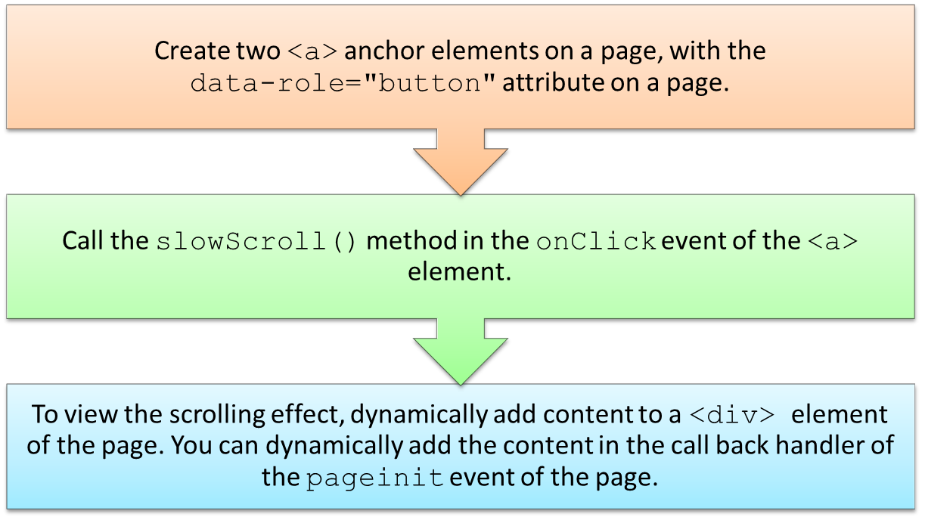
Creating a Basic jQuery Mobile Application (Contd.)
You can use the jQuery Mobile API to scroll up and down a page by calling the slowScroll() method on the $.mobile object.
To perform scrolling in a jQuery Mobile page:

Slide 21
Just a Minute
Which one of the following templates enables you to create a standard HTML5 document that acts as an independent Web page?
  Single-page template
  Multi-page template

Slide 22
Just a Minute (Contd.)
Answer:
  Single-page template

Slide 23
Activity: Implementing Page Navigation in a jQuery Mobile Application
PizzaBud is a Pizza outlet operating in the Abington town of Louisiana.
Customers of PizzaBud walk in to the outlet to order and take away pizzas. Customers also order pizzas by calling the outlet over phone. PizzaBud periodically updates its pizza menu by introducing new pizzas and providing special discounts. To update customers with their new menu, PizzaBud prints
and distributes their menus to customers. During a management meeting of PizzaBud, the management realized the need to introduce an innovative
approach so that the customers can easily get informed of newly introduced pizzas and discount offers before they place an order. Accordingly, the management decided to launch a mobile Web application that will allow customers to browse through their pizza menu and offers on the move.
As a step towards this aim, the management shares its requirements with EarnestIT, a software development company. Patrick, the Project Head in EarnestIT, along with his project team, has gathered the requirements of PizzaBud. You are a part of the project team of EarnestIT. During the
requirement gathering phase, the management has specifically stated that the PizzaBud Web application should be accessible consistently across different mobile devices.

Slide 24
Activity: Implementing Page Navigation in a jQuery Mobile Application (Contd.)
Your team decides to use jQuery Mobile to design the initial structure of the application. The initial structure will contain the home and about us pages and a contact us dialog with navigation features between them.
You have been assigned by Patrick to create the home page, the about us page and a contact us dialog for the PizzaBud application. Based on the documented application requirements, you need to ensure that:
  The home page will be composed of multiple page containers with related content that can be scrolled up and down.
  The home page, the about us page, and the contact us dialog should allow a user to navigate back and forth.
  When a user navigates from the home page to the about us page, the home page
  should flip before the content of the about us page is displayed.
  When a user navigates from the home page to the contact us dialog, the contact us dialog should pop up.
  As users will most frequently access the contact us dialog to access the phone numbers for ordering pizzas, the contact us dialog should be pre-fetched when the home page loads. The contact us dialog should also be cached.

Slide 25
Activity: Implementing Page Navigation in a jQuery Mobile Application (Contd.)
You now need to create the initial structure of the PizzaBud application.
Prerequisite: To perform this activity, you need to use the PizzaBud.zip file.

Slide 26
Summary
In this session, you learned that:
  jQuery Mobile is a UI framework that you can use to create cross-platform Web applications for a wide range of mobile devices.
  jQuery Mobile uses HTML5, CSS3, and jQuery JavaScript library, which are standard technologies that all mobile Web browsers support, to create Web applications for mobile devices.
  jQuery Mobile provides the following two types of page templates to create mobile
  Web pages:
    Single-page template
    Multi-page template
  Page transition is an animated effect that defines how a page gets displayed when being navigated from one page to another.

Slide 27
What’s Next?
After this session, you need to do the following tasks:
  Read Chapter 9
  Perform Exercise 1 of Chapter 9

